Slide 1

TiDB Workshop
Friday 28 July, Berlin, WeAreDevelopers

Slide 2
Table of Content
Introduction
Environment setup
Lab exercises
Conclusions

Slide 3
Introduction
Mattias Jonsson
  Working for PingCAP as Senior Database Engineer, developing TiDB
  Previous:
    Senior Developer / Engineering manager at Booking.com
    Senior Software Engineer at MySQL/Sun/Oracle
Daniël van Eeden
  Working for PingCAP as Technical Support Engineer
  Previous
    Senior Database Engineer at Booking.com
    Long time member in the MySQL Community

Slide 4


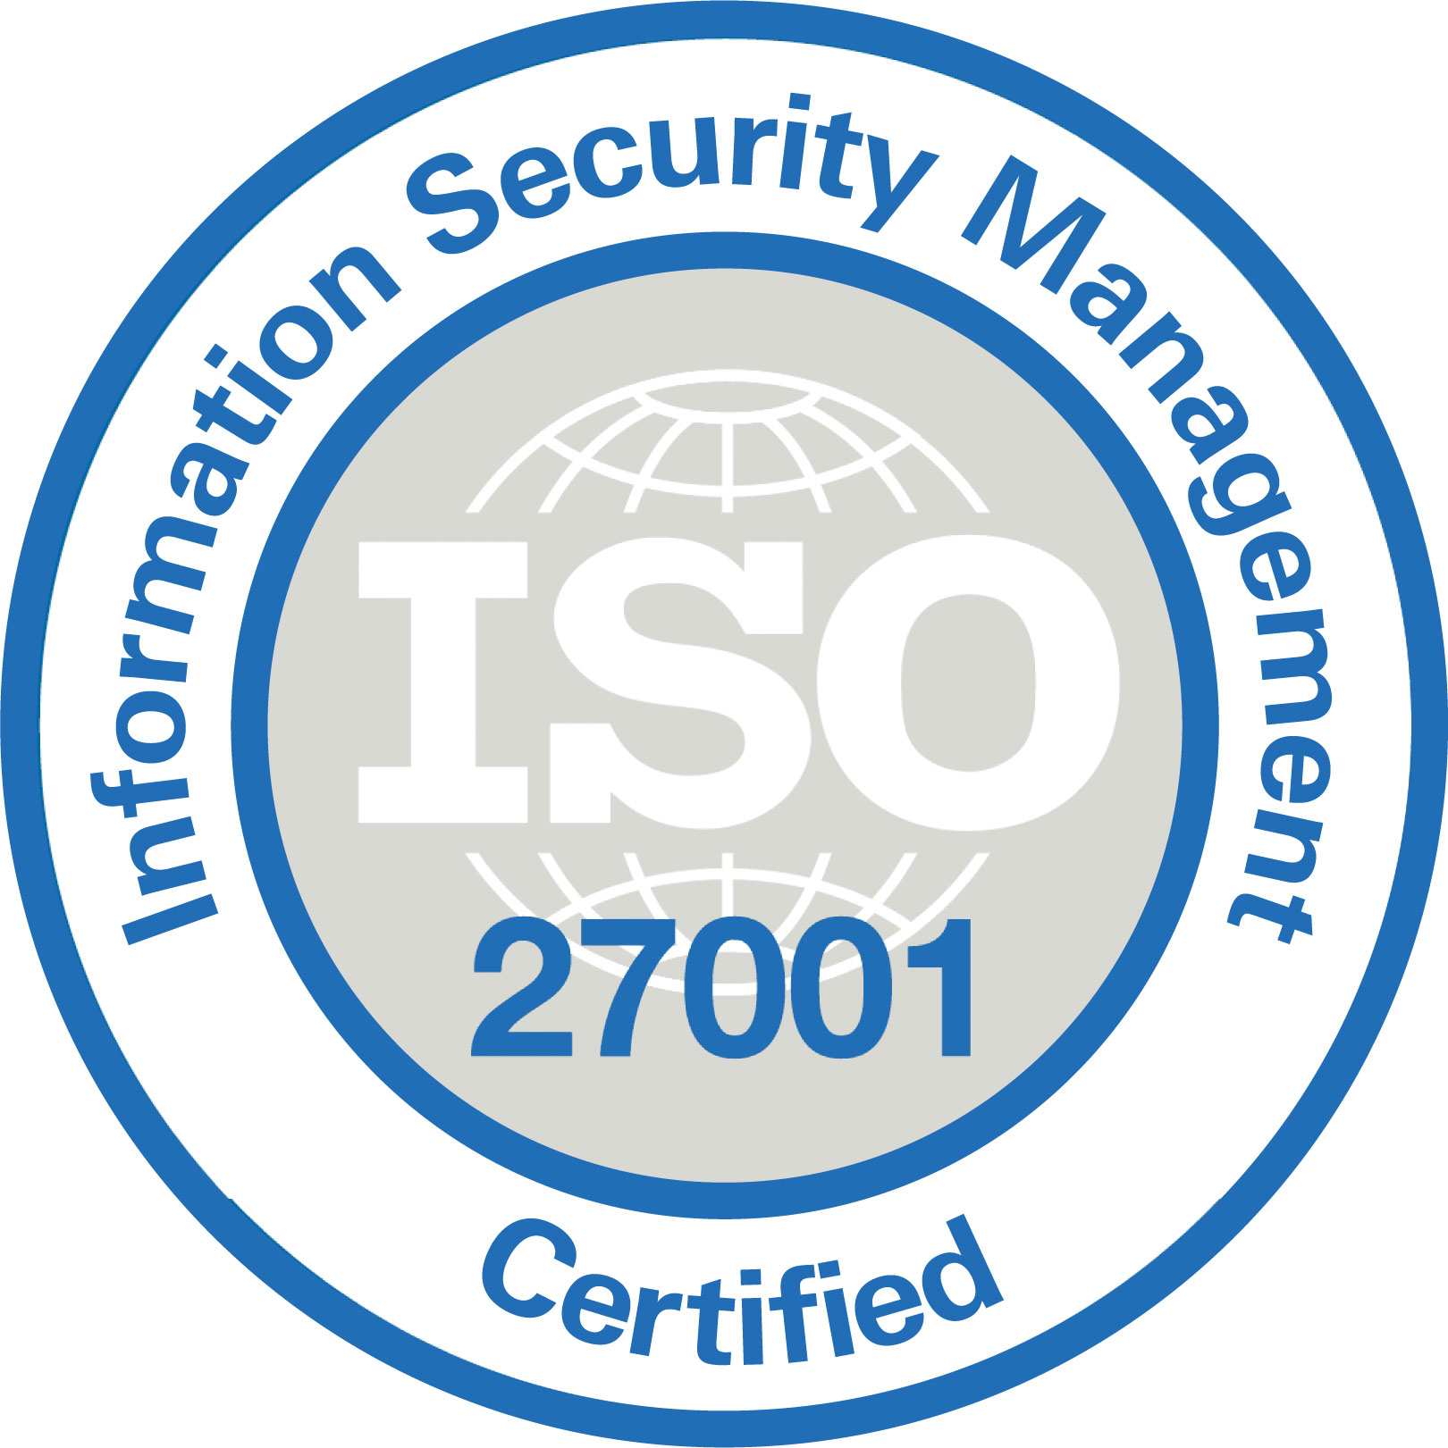

About PingCAP
PingCAP, the company behind TiDB, provides enterprise-level and cloud-based services and technology for TiDB, so companies can count on TiDB as its core database solution to simplify the database infrastructure and create business value faster than ever.
Mission: Empower engineers to innovate with Speed, Agility, and Scale.

Slide 5

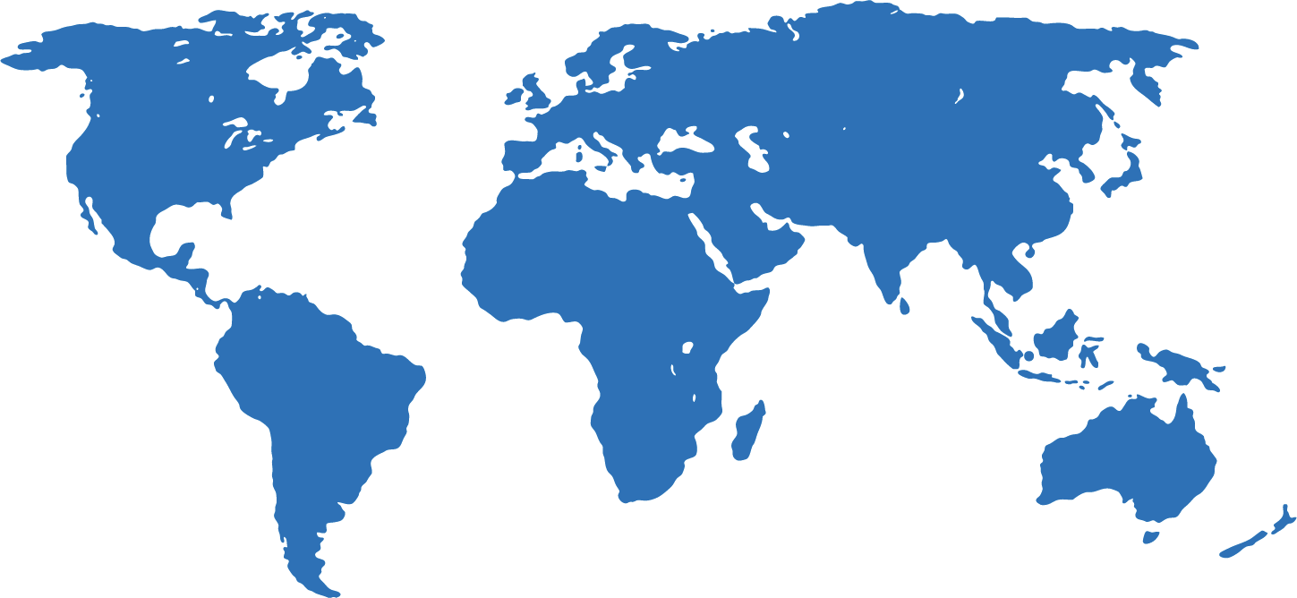
About PingCAP
Founded in 2015
The company behind TiDB
Global
Open source culture
Strong investors
600+ employees
Amsterdam
Silicon Valley
Beijing
Tokyo
Tokyo
Shanghai
Singapore
Singapore
Notes:
Development out in the open: code, issues, pull requests, designs
https://github.com/pingcap
TiDB Cloud. Database-as-a-Service.

Slide 6










About PingCAP
Trusted and Verified by Vertical Leaders Globally
2000+ production adopters
And
Airbnb, Pinterest, Niantic
2 out of top 3 Cryptocurrency Exchanges
One of Top 3 biggest banks all over the world

Slide 7
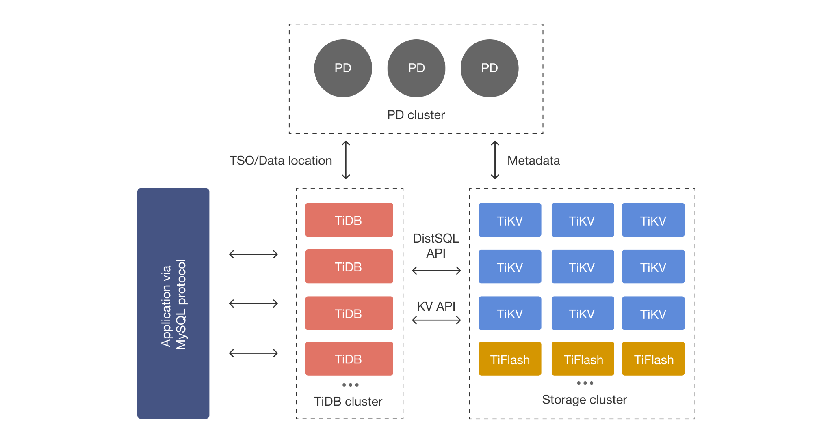
Notes:
https://docs.pingcap.com/tidb/stable/tidb-architecture

Slide 8
Environment setup
Database:
TiDB Locally with TiUP via https://tiup.io
MySQL Locally
Optional: TiDB Cloud
  via https://tidbcloud.com (Free serverless tier)
  select eu-central-1 as location for your cluster
Application:
demoblog
https://github.com/dveeden/demoblog
Database client:
MySQL Client
TiDB Cloud Console (Chat2Query)
Notes:
In production one would use:
TiUP Cluster
TiDB Operator for Kubernetes
TiDB Cloud

Slide 9
Environment setup
AWS
This presentation (for easier li
EC2 hosts, pick one from this spreadsheet.
shared keypair
  For simplicity we use the same private key for ssh
  Log in with your ssh client, like:
  ssh -i tidb-workshop.pem ubuntu@3.78.221.19
  Download the demoblog repository:
  git clone https://github.com/dveeden/demoblog.git
  Setup the environment (will also start MySQL Server)
  ./demoblog/AWS/setup_workshop.sh
port forwarding (for later)
  ssh -L8080:127.0.0.1:8080 -L2379:127.0.0.1:2379 -L 3000:127.0.0.1:3000 -i tidb-workshop.pem ubuntu@3.78.221.19
  http://127.0.0.1:8080 Demoblog
  http://127.0.0.1:2379/dashboard PD dashboard (root/)
  http://127.0.0.1:3000/ Grafana (admin/admin)
Notes:
https://www.puttygen.com/convert-pem-to-ppk for those that want to use PuTTY
# When using ~/.ssh/config:
Host wearedev
Hostname 1111.111.111.111
User ubuntu
IdentityFile ~/tidb-workshop.pem

Slide 10
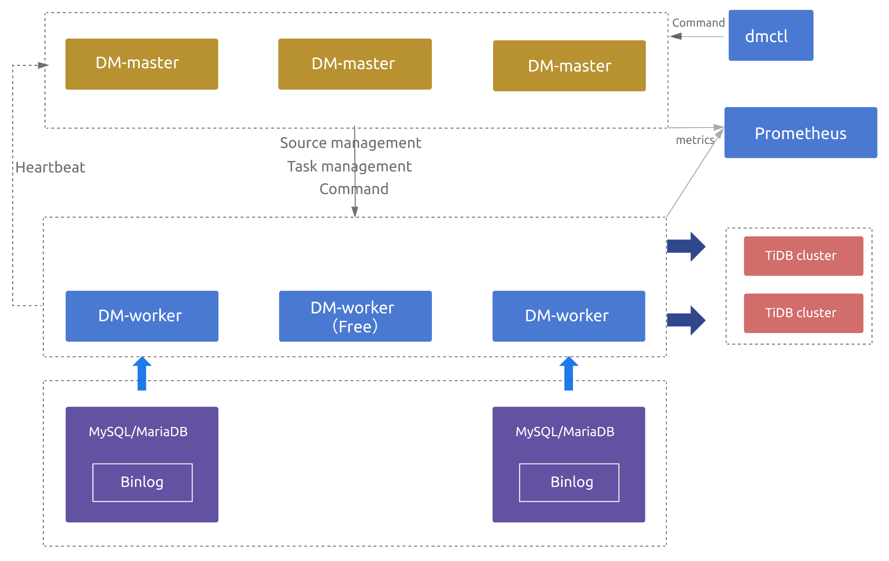
Migrate to TiDB from MySQL
Data Migration (DM)
Replicate data from MySQL to TiDB.
Uses Dumpling/Lightning to copy the initial copy.
Note that this is also made to be high available.
Notes:
Dumpling is for exporting data
Lightning is for importing data
DM is for migrating data
Explain:
MySQL Compatibility for migration
DM setup is HA
DM can combine shards

Slide 11
Lab excercises: DM 1/2
Run demoblog with MySQL
~/demoblog/demoblog -db 'blog:blog@tcp(127.0.0.1)/blog?parseTime=true'
Make sure the application works (check http://127.0.0.1:8080 (via portforward))
Run TiUP Playground (in a new ssh session)
tiup playground v7.2.0
Run DM master (in a new ssh session)
./dm-master -master-addr 127.0.0.1:8261
Run DM worker (in a new ssh session)
./dm-worker -worker-addr 127.0.0.1:8262 -join 127.0.0.1:8261
Check DM status (in a new ssh session)
./dmctl -master-addr 127.0.0.1:8261 query-status
Notes:
https://docs.pingcap.com/tidb/dev/deploy-a-dm-cluster-using-binary
Separate sessions for:
DM Master
DM Worker
Playground
Demoblog
dmctl, mysql client, etc

Slide 12
Lab excercises: DM 2/2
Repo:
DM/mysql-source.yaml
DM/dm-task.yaml
cd demoblog/DM
~/dmctl -master-addr 127.0.0.1:8261 operate-source create mysql-source.yaml
~/dmctl -master-addr 127.0.0.1:8261 start-task dm-task.yaml
~/dmctl -master-addr 127.0.0.1:8261 query-status mysql-to-tidb
Check:
sudo mysql blog
mysql -u root -h 127.0.0.1 -P 4000 blog
Query: SELECT * FROM posts;
Stop application and run again with TiDB (go back to the demoblog session, to simulate a switch to TiDB)
^C
# (demoblog uses TiDB by default, so no uri needed)
~/demoblog/demoblog
OK to stop the dm-master and dm-worker processes now, since traffic to MySQL is moved to TiDB.

Slide 13

Placement Driver (PD)
The placement driver:
Has etcd embedded
Is the Time Stamp Oracle (TSO): it gives out timestamps. These timestamps are used in transactions and in the MVCC system
Takes care of data placement:
  TiKV servers have labels
  labels are used to ensure a raft group spans multiple availability zones
  Splitting big data regions, merging small data regions, splitting hot data regions, evenly distributing regions across the cluster.
Notes:
The active scheduler makes sure the load is evenly spread even when the workload changes

Slide 14
TiDB Server
TiDB Server is one of the components of the TiDB Platform. This is a bit confusing.
TiDB Server is written in Go and doesn't share any code with MySQL.
This implements the MySQL protocol, optimizer and executor.
TiDB sql node is stateless, it doesn't contain data.
Notes:
The MySQL protocol is not a standard. Documentation is not always clear.

Slide 15
TiKV
TiKV is a distributed key-value store. This is a CNCF project.
Database tables are stored with a RowID or PK as key and the columns as values.
A database table is split up into multiple data regions. Each data region is a raft group of (by default) three nodes.
Notes:
CNCF = Cloud Native Compute Foundation

Slide 16
Query Execution/Distributed Computing
SELECT COUNT(*) FROM t WHERE id > 10 AND c2 = 'foo';
Physical Plan on TiDB
Final Aggregate
SUM(COUNT(*))
Physical Plan on TiKV Coprocessor
COUNT(*)
Partial Aggregate
COUNT(*)
DistSQL Scan
Filter
c2 = 'foo'
COUNT(*)
COUNT(*)
TiKV
COUNT(*)
TableScan
Range: id(10, +∞)
TiKV
TiKV
Notes:
Pushdown to TiKV
Pushdown to TiFlash

Slide 17
TiDB Architecture
AZ 1
AZ 2
AZ 3
Stateless SQL Layer
TiKV node 1
TiKV node 2
TiKV node 3
UPDATE orders
SET delivered = 1 WHERE id = 12345
TiDB node 1
Region 5
Region 1
Region 2
TiDB node 2
Region 3
Region 2
Region 4
Region 4
Region 3
Region 5
TiDB node 3
TiKV node 4
TiKV node 5
TiKV node 6
Region 1
Region 5
Region 6
Region 6
Region 6
Region 1
Region 2
Region 4
Region 3
Notes:
Here you can see that the orders table on the bottom left is split by primary key into three data regions. This splitting is done by the system and not by the user.
Region 3 has 3 members: one leader and two followers.
Reads and writes go to the leader of the region.
If a region fails a new leader is elected if the majority of the region is still available

Slide 18
Scalability with TiDB
Both reads and writes can go to any of the TiDB nodes.
Scaling reads?
Add more nodes
Scaling writes?
Add more nodes
Scaling data volume?
Add more nodes
Need to scale more?
Add more nodes
Notes:
TiKV uses RocksDB which has an LSM-tree structure and provides much better compression ratios than MySQL does with InnoDB.
Data is distributed over the TiKV nodes. For clusters of more than three nodes the individual nodes only store a subset of the data.
TiDB (compute) and TiKV (storage) nodes can be scaled up individually.

Slide 19
TiDB Architecture
AZ 1
AZ 2
AZ 3
Stateless SQL Layer
TiKV node 1
TiKV node 2
TiKV node 3
TiDB node 1
Region 5
Region 1
Region 2
TiDB node 2
Region 3
Region 2
Region 4
Region 4
Region 3
Region 5
TiDB node 3
TiKV node 4
TiKV node 5
TiKV node 6
Region 1
Region 5
Region 6
Region 6
Region 6
Region 1
Region 2
Region 4
Region 3
Notes:
Let's add more capacity by adding more nodes

Slide 20
TiDB Architecture
AZ 1
AZ 2
AZ 3
TiKV node 1
TiKV node 2
TiKV node 3
Region 5
Region 1
Region 2
Stateless SQL Layer
Region 3
Region 2
Region 4
Region 4
Region 3
Region 5
TiDB node 1
TiDB node 2
TiKV node 4
TiKV node 5
TiKV node 6
Region 1
Region 5
Region 6
TiDB node 3
Region 6
Region 6
Region 1
Region 2
Region 4
Region 3
TiDB node 4
TiKV node 7
TiKV node 8
TiKV node 9
Notes:
We added 3 TiKV nodes and 1 TiDB node

Slide 21
TiDB Architecture
AZ 1
AZ 2
AZ 3
TiKV node 1
TiKV node 2
TiKV node 3
Region 5
Region 1
Region 2
Stateless SQL Layer
Region 3
Region 4
Region 3
TiDB node 1
TiDB node 2
TiKV node 4
TiKV node 5
TiKV node 6
Region 5
Region 6
TiDB node 3
Region 6
Region 1
Region 2
Region 4
TiDB node 4
TiKV node 7
TiKV node 8
TiKV node 9
Region 1
Region 6
Region 3
Region 4
Region 2
Region 5
Notes:
Regions get redistributed
The number of regions get distributed evenly. 2 regions per store in this case.
The number of leaders also gets distributed evenly. None of the stores should have more than one leader in this case.
In practice the number of regions will be much higher as these are around 96 MiB. Ten thousands of regions is normal.

Slide 22
Lab excercises: TiKV
MySQL Client:
mysql -u root -h 127.0.0.1 -P 4000 blog
SHOW TABLE comments REGIONS;
Run loadGen (in a new ssh session)
cd demoblog/loadGen
./loadGen
SHOW TABLE comments REGIONS;
SELECT REGION_ID,START_KEY,END_KEY,TABLE_NAME,INDEX_NAME FROM information_schema.TIKV_REGION_STATUS WHERE DB_NAME='blog';
Check Key Visualizer in TiDB Dashboard
ssh -L2379:127.0.0.1:2379 …
http://127.0.0.1:2379/dashboard/
Notes:
https://docs.pingcap.com/tidb/stable/dashboard-key-visualizer
To generate more data quickly:
INSERT INTO comments(post_id,body) SELECT post_id,body FROM comments;
Bigger index:
ALTER TABLE comments ADD INDEX(body(768));

Slide 23
Lab excercises
Scale out via TiUP Playground:
tiup playground display
tiup playground scale-out --kv 2
tiup playground display
tiup ctl:v7.2.0 pd store
curl http://127.0.0.1:2379/pd/api/v1/stores
SQL:
SELECT * FROM information_schema.TIKV_STORE_STATUS;
SELECT REGION_ID,START_KEY,END_KEY,TABLE_NAME,INDEX_NAME FROM information_schema.TIKV_REGION_STATUS WHERE DB_NAME='blog';
SELECT * FROM information_schema.TIKV_REGION_PEERS WHERE REGION_ID=<id from one of the regions above>;

Slide 24
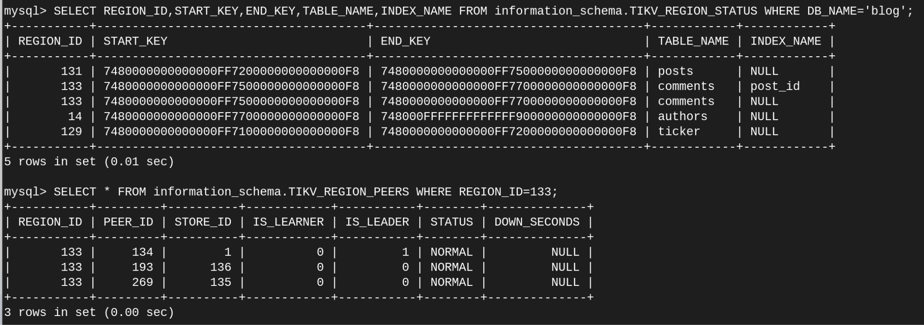

Slide 25
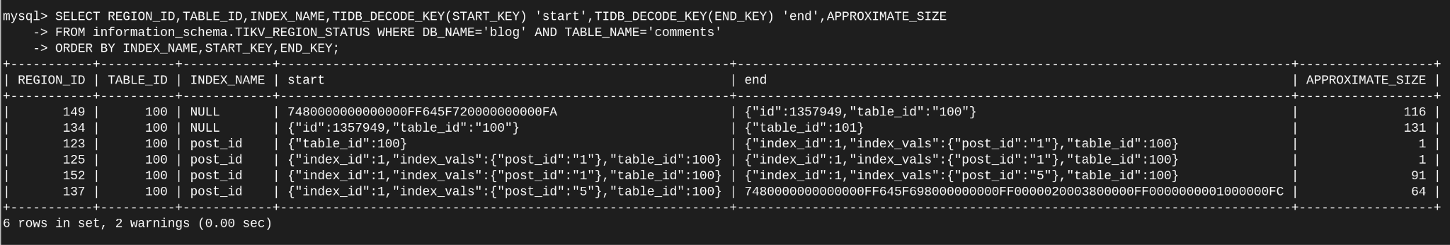
TIDB_DECODE_KEY() to decode keys
Notes:
https://docs.pingcap.com/tidb/stable/tidb-functions

Slide 26
Lab excercises
Add yet another TiKV node, so we safely can remove one:
tiup playground scale-out –-kv 1
Scale in via TiUP Playground:
tiup playground display
tiup playground scale-in --pid $pid
Scaling in TiDB nodes will be quick. TiKV might need to move data.
Notes:
Add one more kv node, otherwise when scale-in, it will not finish due to 3 replicas…

Slide 27
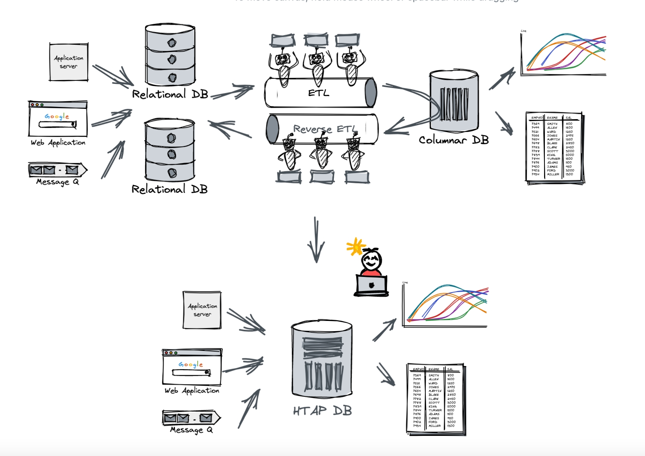
Anyone recognizes similar architecture?

Slide 28
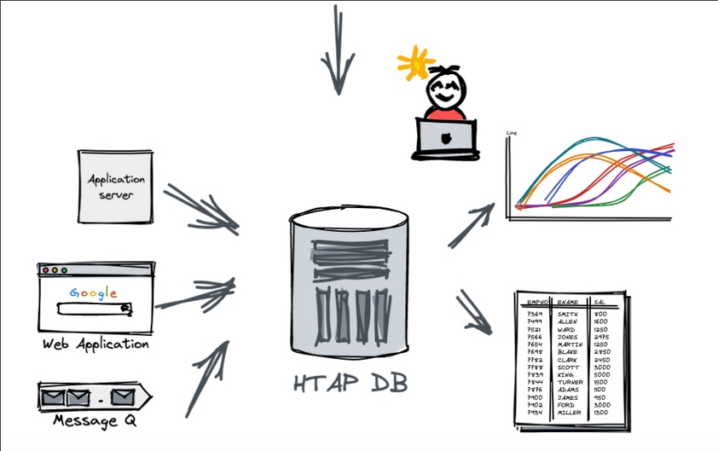
What if it could be simplified to this?

Slide 29
TiDB Architecture with TiFlash
AZ 1
AZ 2
AZ 3
TiKV node 1
TiKV node 2
TiKV node 3
Region 5
Region 1
Region 2
Stateless SQL Layer
Region 3
Region 2
Region 4
UPDATE orders
SET delivered = 1 WHERE id = 12345
Region 4
Region 3
Region 5
TiDB node 1
TiDB node 2
TiKV node 4
TiKV node 5
TiKV node 6
Region 1
Region 5
Region 6
TiDB node 3
Region 6
Region 6
Region 1
Region 2
Region 4
Region 3
TiDB node 4
TiFlash 1
TiFlash 2
Region 1
Region 2
Region 6
Region 3
Region 6
Notes:
The orders table with region 1, 2 and 3 has one copy on TiFlash.
Region 6: Two copies on TiFlash
Region 5: No copies on TiFlash

Slide 30
The optimizer can pick the best store for each case
SELECT AVG(s.price) FROM
prod p, sales s
WHERE p.pid = s.pid
AND p.batch_id = ‘B1328’;
TiDB
IndexScan prod
(pid, batch_id = ‘B1328’)
TableScan sales
(price,pid)
TiKV node 1
TiKV node 2
TiKV node 3
TiKV node 4
TiFlash node 1
TiFlash node 2
Store 1
Store 2
Store 3
Store 4
Store 5
Store 6
Range 2
Range 1
Range 1
Range 1
Range 1
Range 3
Range 2
Range 4
Range 2
Range 4
Range 3
Range 3
Range 4

Slide 31
Lab excercises: TiFlash
Setup TiFlash replicas
ALTER TABLE posts SET TIFLASH REPLICA 1;
ALTER TABLE comments SET TIFLASH REPLICA 1;
EXPLAIN SELECT p.title, SUM(c.likes) FROM posts p LEFT JOIN comments c ON c.post_id=p.id GROUP BY p.id;
Run loadGen for a bit and run explain again.
Try EXPLAIN ANALYZE <query>
Try engine isolation:
SET SESSION tidb_isolation_read_engines = "tikv";
EXPLAIN …
SET SESSION tidb_isolation_read_engines = "tiflash,tikv";
Only adding TiFlash for comments allows joins between comments and posts. This combines TiKV and TiFlash
Notes:
https://docs.pingcap.com/tidb/stable/use-tidb-to-read-tiflash#engine-isolation
Also optimizer hint: explain select /*+ READ_FROM_STORAGE(TIFLASH[t]) */ count(*) from t
Was:
EXPLAIN SELECT p.title,COUNT(c.id) FROM posts p LEFT JOIN comments c ON c.post_id=p.id GROUP BY p.id;

Slide 32
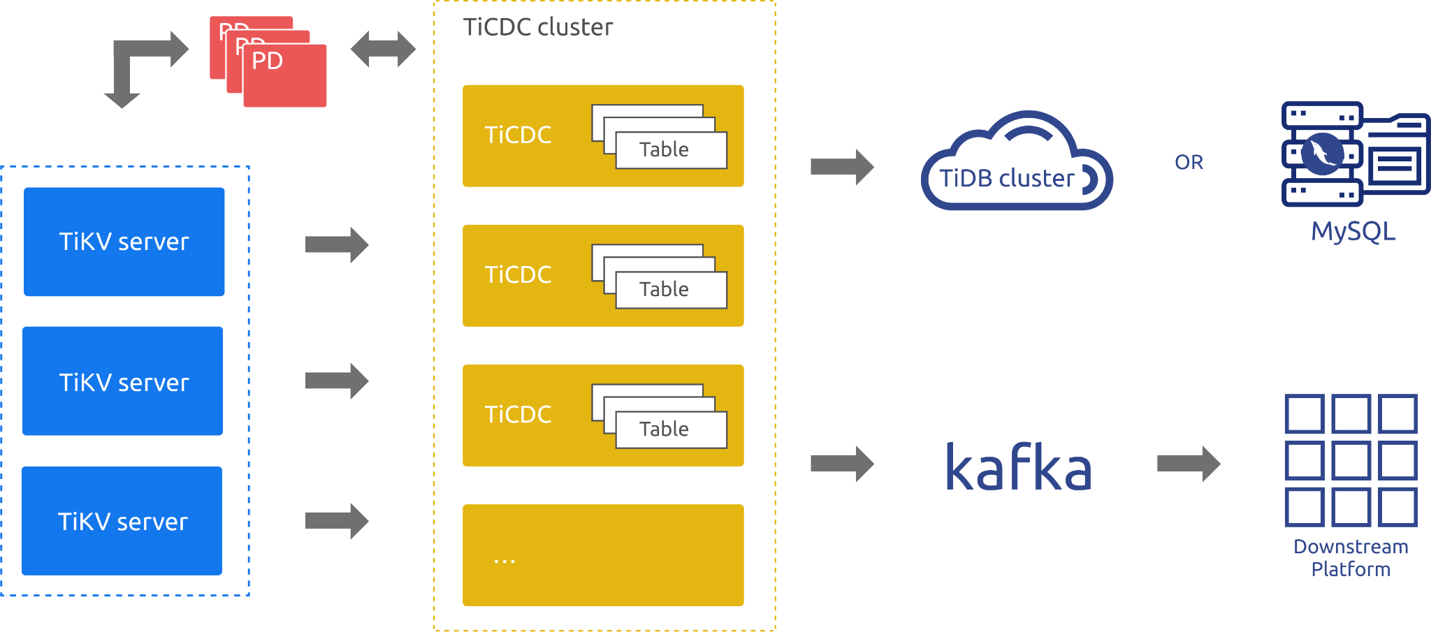
Batteries included: TiCDC
TiCDC
Change Data Capture
Send events to Kafka, MySQL or another TiDB Cluster.
Also high available

Slide 33
Lab excercises: TiCDC
Try ticketStat:
Setup Kafka
Setup TiCDC changefeed to kafka
Run tickerStat (consumes kafka)
cd demoblog/tickerStat
cat README.md

Slide 34
Compatibility
TiDB is compatible with the MySQL protocol and syntax of MySQL 5.7 and MySQL 8.x. There are a few differences.
Row size is limited to 120 MiB.
TiDB differences:
AUTO_INCREMENT, AUTO_RANDOM (but there is a MySQL compatible mode)
Explain output is different
No triggers, stored procedures, etc: Use TiCDC changefeed instead.
No fulltext index
No geospatial support
https://docs.pingcap.com/tidb/stable/mysql-compatibility
Notes:
https://docs.pingcap.com/tidb/stable/mysql-compatibility
Put a +1 on the GitHub issues and/or let us know directly about what missing features or differences are most important to you.

Slide 35
Lab excercises: Compatibility
Try queries:
SELECT p.title,p.likes,SUM(c.likes) 'liked comments'
FROM posts p
LEFT JOIN comments c ON c.post_id=p.id GROUP BY p.id;
Try some tools like MySQL Workbench, DBeaver, etc. This might need portforwarding of port 4000: ssh -L4000:127.0.0.1:4000 …
https://docs.pingcap.com/tidb/stable/mysql-compatibility
Most ORM's just work with MySQL compatibility. There are some that implement TiDB specific features and settings (e.g. default port as 4000)
Notes:
https://docs.pingcap.com/tidb/stable/mysql-compatibility

Slide 36
Lab excercises: Online DDL
Drop and Add INDEX
ALTER TABLE comments DROP INDEX post_id;
ALTER TABLE comments ADD INDEX post_id (post_id);
Foreign Keys
ALTER TABLE comments
ADD CONSTRAINT fk_postid FOREIGN KEY (post_id) REFERENCES posts(id),
ADD CONSTRAINT fk_authorid FOREIGN KEY (author_id) REFERENCES authors(id);
ALTER TABLE posts
ADD CONSTRAINT fk_authorid FOREIGN KEY (author_id) REFERENCES authors(id);
-- This should fail as there is no author with that ID.
UPDATE posts SET author_id=2 WHERE id=1;

Slide 37
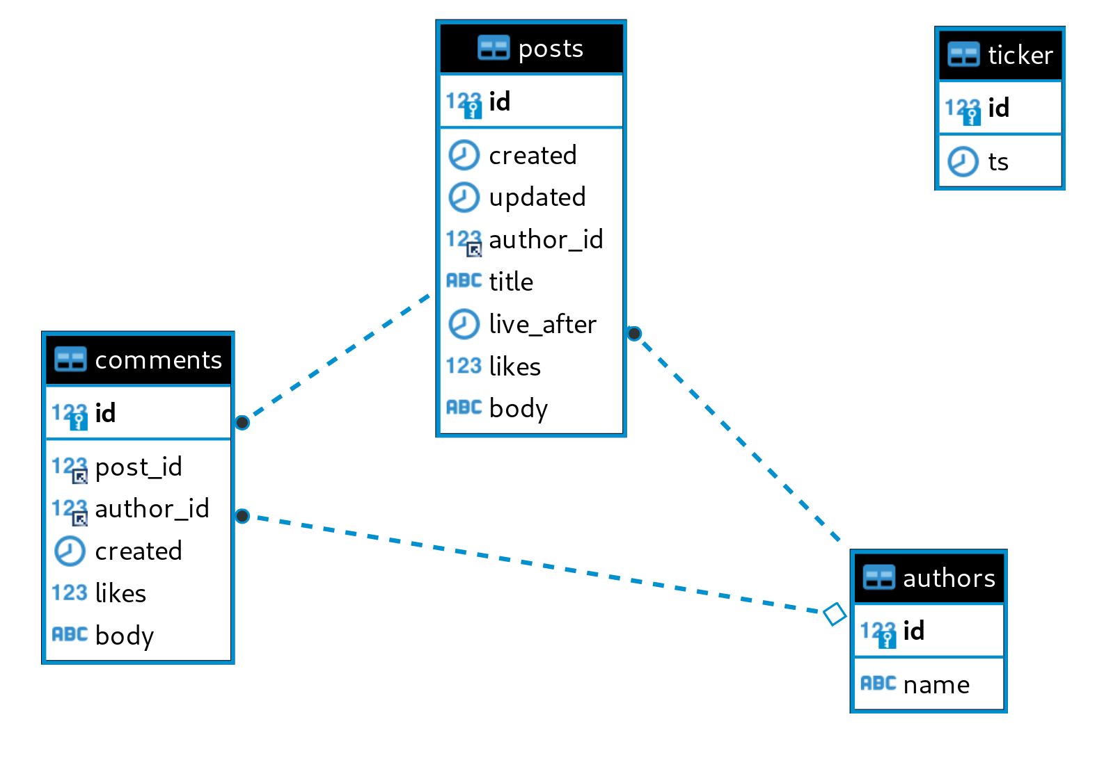


Slide 38
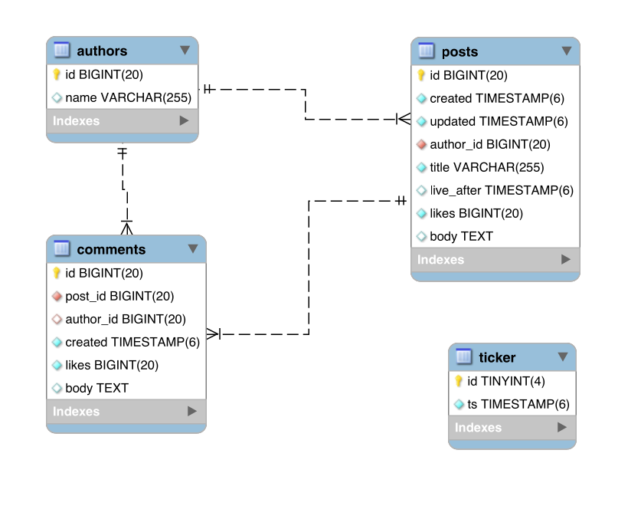


Slide 39
Time travel with TiDB
Data is never actually removed directly, it is garbage collected instead.
This allows you to see any version between now and the point of the GC.
Use SELECT ... FROM ... AS OF TIMESTAMP
Works for both table data and table structure
Dumpling can dump data of a specific time
Default GC life time is 10 minutes
FLASHBACK statement can recover the last version of a table, database or a full cluster
Notes:
https://docs.pingcap.com/tidb/stable/read-historical-data
https://docs.pingcap.com/tidb/stable/sql-statement-flashback-table

Slide 40
Lab excercises
Time travel: AS OF…
SELECT post_id,COUNT(*),SUM(likes)
FROM comments AS OF TIMESTAMP '2023-07-28 15:25:11'
GROUP BY post_id;
FLASHBACK TABLE & BR
# This was in dev environment right?!
DROP TABLE comments;
# Oh no, prod :o (loadGen probably crashed…)
FLASHBACK TABLE comments;
# Restart the loadGen and it should work again \o/

Slide 41
Lab excercises
Now check the various dashboards:
http://127.0.0.1:2379/dashboard PD dashboard (root/)
http://127.0.0.1:3000/ Grafana (admin/admin)

Slide 42
Backup and Restore
BR: Backup and Restore
Every TiKV node writes it's own backup to S3 or other shared storage. Similar for restores. This makes backups scalable.

Slide 43
Lab excercises: BR
Create a backup
tiup br backup full -s file:///tmp/b1
Decode backup metadata
tiup br validate decode -s /tmp/b1/
Get the TSO of the backup
jq .end_version /tmp/b1/backupmeta.json
Get the timestamp for the TSO
tiup ctl:v7.2.0 pd tso $tso
Simlar, via SQL: SELECT TIDB_PARSE_TSO($tso)

Slide 44
Lab excercises: BR & TSO
WITH tso AS (
SELECT 443165077170552833 v
)
SELECT
v 'TSO raw',
(v >> 18)/1000 'TSO unix timestamp',
FROM_UNIXTIME((v >> 18) / 1000) 'TSO timestamp',
TIDB_PARSE_TSO(v),
v - ((v >> 18) << 18) 'TSO logical part'
FROM tso\G
443165077170552833 in binary:
0000011000100110011100000100101000101001100111000000000000000001
< 46 bits physical timestamp >< 18 bit logical >

Slide 45
Dumpling and Lightning
Dumpling does parallel export of data from TiDB or MySQL
Lightning does:
Data loading directly into TiKV (ingesting SST files, "local" backend)
Data loading via TiDB (via SQL, "tidb" backend)
By default filenames are used as metadata, just like MyDumper and MyLoader.
Files can be local or on S3. (Not on AWS? use S3 compatible storage like MinIO)
TiDB Cloud has a webinterface for imporing data from S3.

Slide 46
Lab excercises: Dumpling
tiup dumpling --database blog --filetype csv -o /tmp/dump
find /tmp/dump

Slide 47
Lab excercises: Lightning
Create data:
mkdir /tmp/authors
cat > /tmp/authors/blog.authors.000000000.csv
"id","name"
2,"Jane Doe"
Import data:
tiup tidb-lightning -d /tmp/authors -backend tidb -tidb-port 4000
Check via SQL:
TABLE authors;

Slide 48
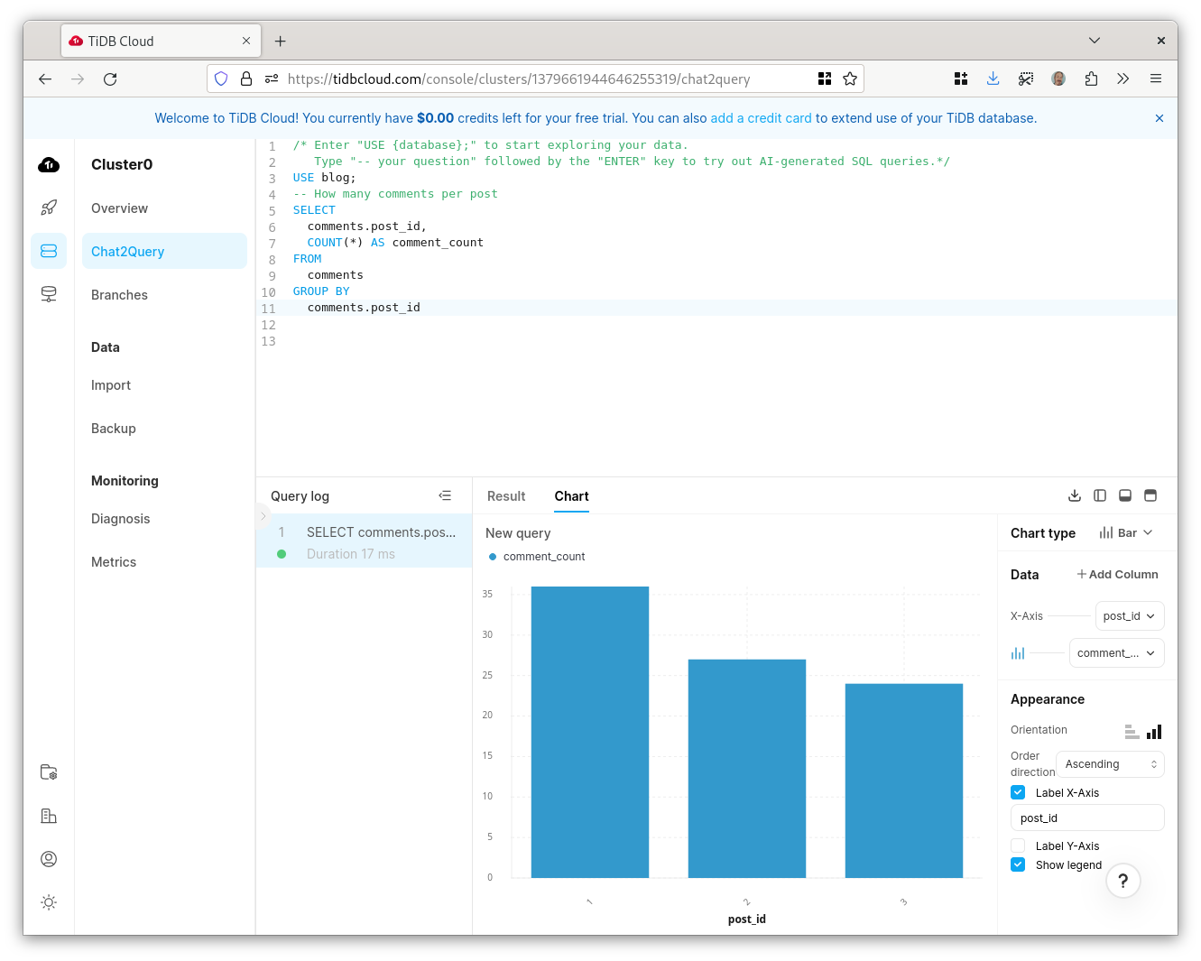
Chat2Query:
AI Generated SQL
Charts

Slide 49
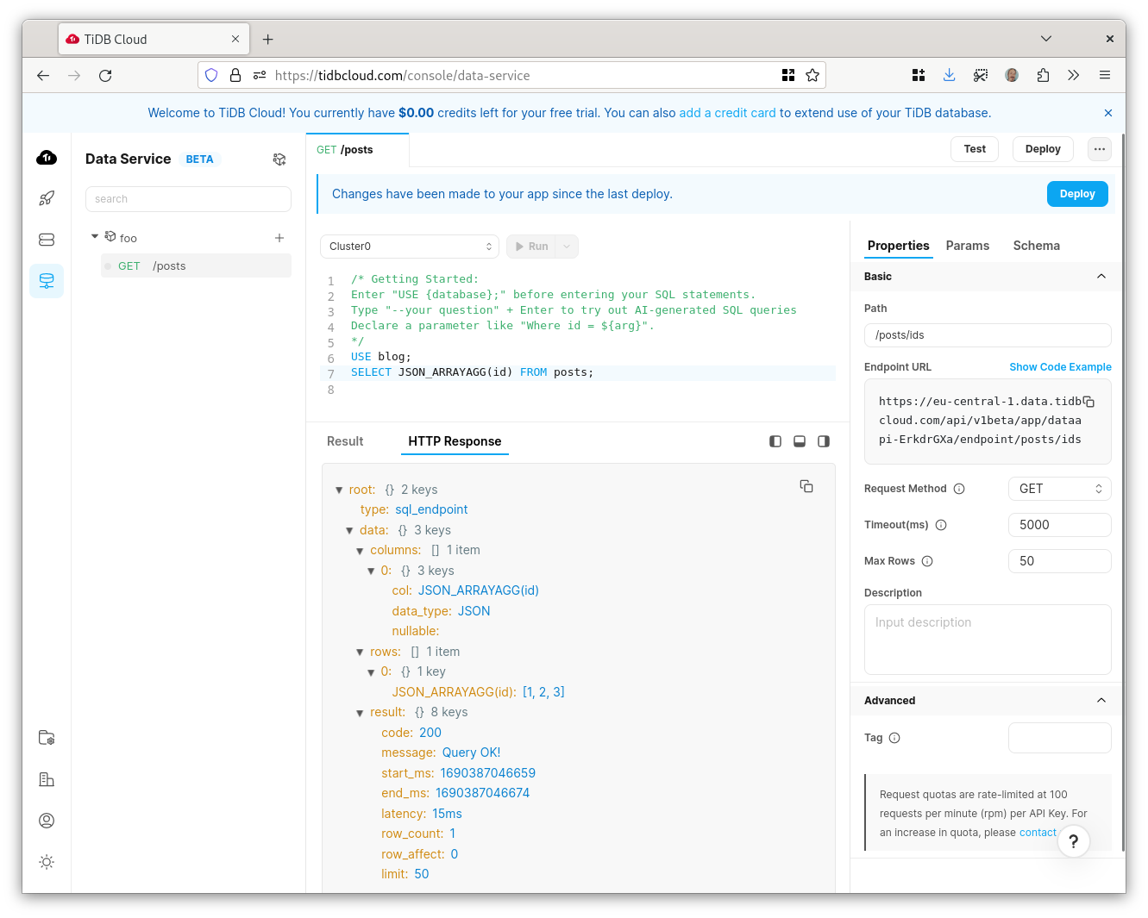
Data Service:
HTTP REST interface based on SQL queries

Slide 50
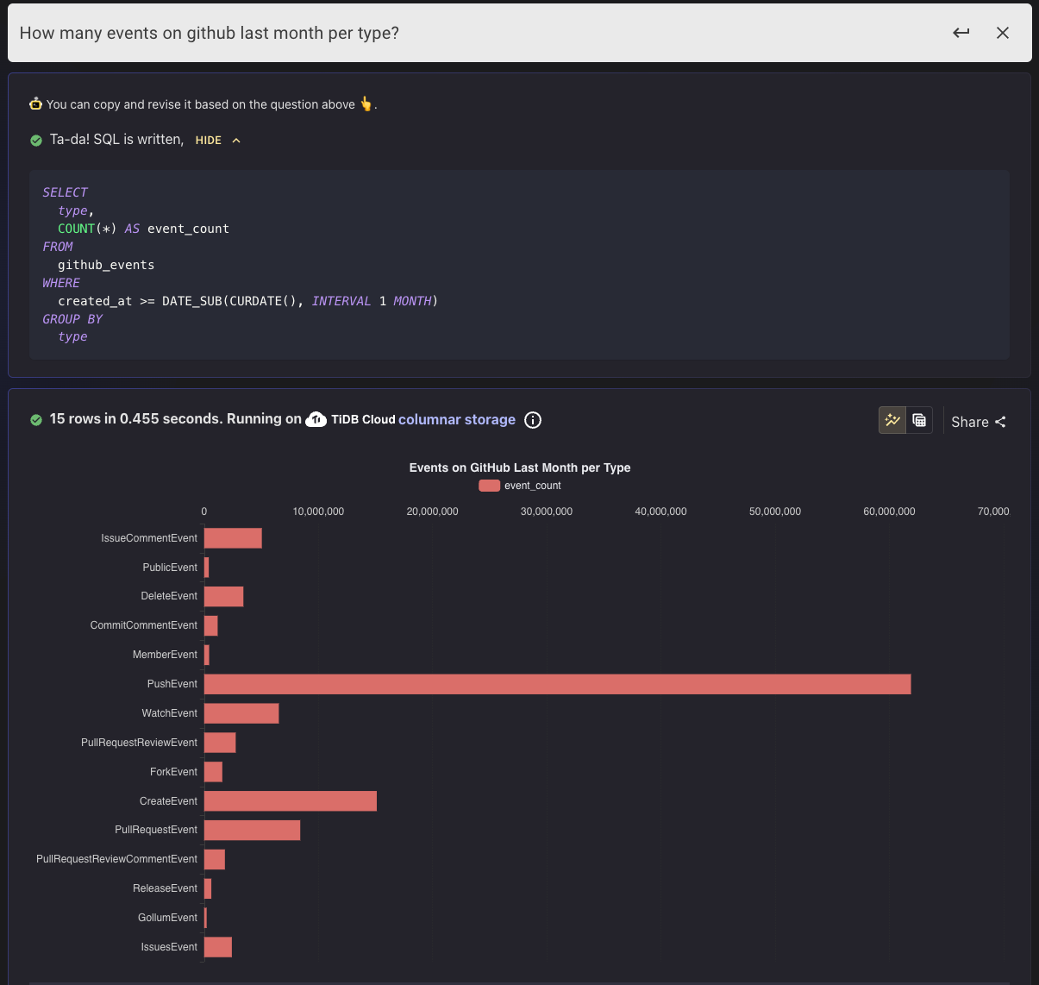
OSS Insight
https://ossinsight.io
Built on TiDB.
6 Billion rows of GitHub events
(Push, Pull, Watch/Star, Issue etc.)
Allows you to look at the SQL,
including explain plans.
No ETL.
Chat2Query

Slide 51
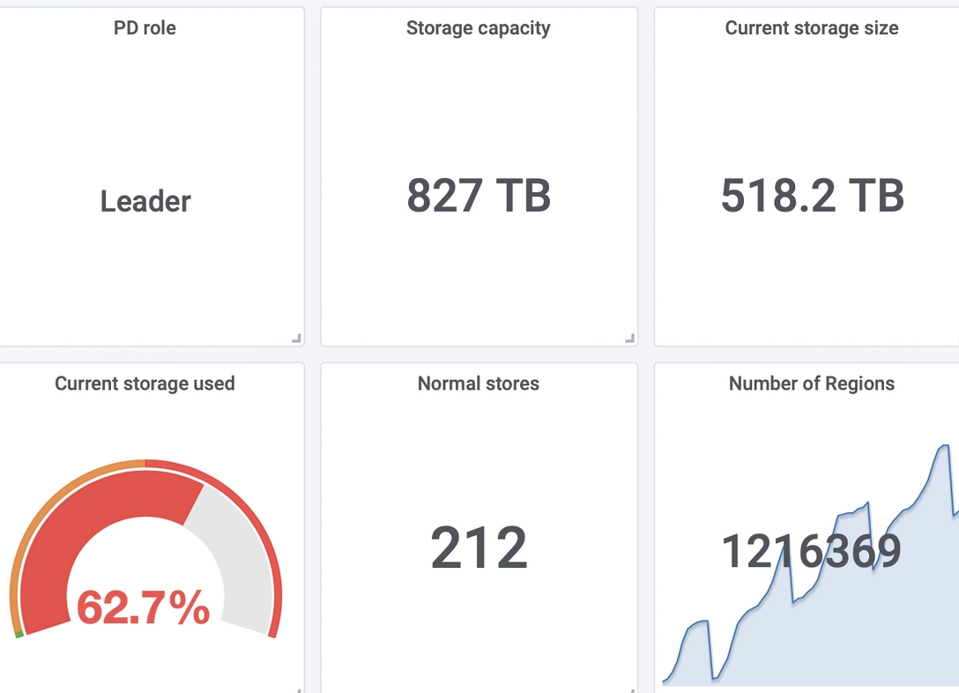
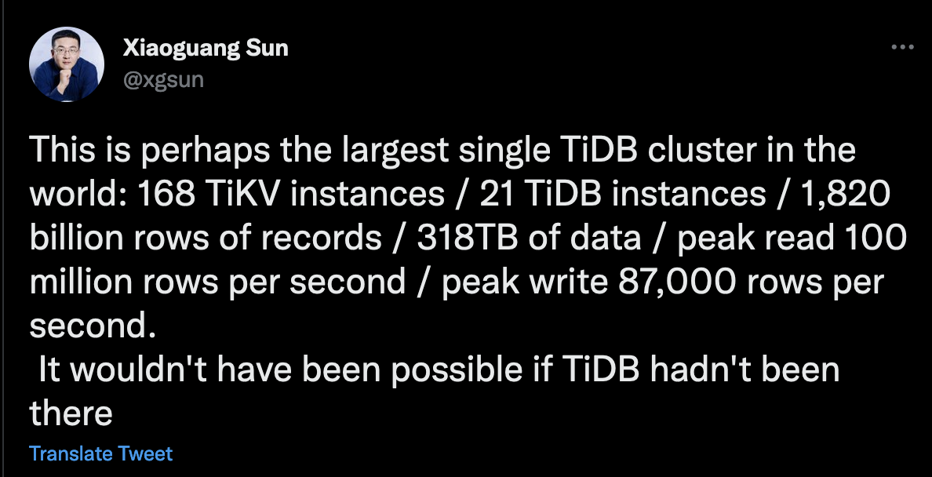
A real-world TiDB cluster in production
Tweets from Xiaoguang Sun, Head of Infrastructure @ Zhihu
Only two engineers are maintaining TiDB at Zhihu →
Dashboard Screenshot of the biggest TiDB cluster running in Zhihu.com
Notes:
https://twitter.com/xgsun/status/1227988509358604288

Slide 52

Conclusions and next steps
TiDB is MySQL compatible
TiDB has fully automatic scaling
TiDB has high availability builtin
TiDB is developer friendly
TiDB allows for online DDL
TiDB can be deployed
  on-prem with TiUP Cluster
  on-prem via Kubernetes with TiDB Operator
  via TiDB Cloud on AWS or GCP
Ask questions via Slack (via QR code)
Give TiDB a try for your application

Slide 53

High availability with MySQL
An often-used setup with MySQL is to have a primary and multiple replicas.
Then if the primary fails you promote a replica.
Replica promotion is not automated.
Is your replica up to date?
Use a load-balancer for service discovery?
How to fail back once the primary is back?
There is no leadership election.
Application
Application
Application
Notes:
Failover with MySQL needs external tools like Orchestrator for automation.
You need to pick the most up to date replica. This might be a machine that has different hardware specs.
Failing over when there is replication delay can lead to unavailability and/or data loss.
There is no leadership election, which can lead to split brain situations.
MySQL has improved over the last few years with GTID and Group Replication. This is in MySQL 8.0.

Slide 54
Scalability with MySQL
With MySQL all writes goes first to the primary, then replicated to all others.
All nodes store a complete copy of the data and applies all the changes.
Application
Application
Application

Slide 55
Scalability with MySQL
Scaling reads?
Add more replicas
Application
Application
Application
Notes:
The application needs to do read-write splitting. Some proxies can do read-write splitting but this never really works as transactions should always be considered to be writes.
Reading from replicas need to take replication delay into consideration
Applications can handle replication delay by:
leaving it to the user. Leave it to the user to refresh the page when just written data isn't visible
trusting "Seconds_behind_master" and waiting. Doesn't work for multiple levels of replication and isn't reliable in general
Retry the read or retry the read from the primary (Good way to DDoS yourself)
Use markers and/or GTID
For DBAs: Use heartbeats to monitor this

Slide 56
Scalability with MySQL
Scaling writes?
Replace the primary with a bigger machine
Application
Application
Application
Notes:
Having different hardware for primary and replicas means that promotion of replicas gets more complicated.

Slide 57
Scalability with MySQL
Scaling data volume?
Add bigger disks
Application
Application
Application
Notes:
All nodes need larger disks.
Having many copies of active data can be useful.
Having many copies of cold data might not be.
This means that cloning servers takes more time.
This means that backup/restore is also going to take more time.

Slide 58
Scalability with MySQL
Need to scale more?
Shard on the application side
Application
Application
Application
Notes:
Sharding adds a lot of complexity for application development and for analytics.
Functional sharding vs. logical sharding
Sharding is only the first step.
Re-sharding is difficult.
Shards might not be distributed evenly (data, hotspots)
Consistency between shards is not guaranteed.
Cross shard queries are often not supported.
Running analytics requires you to query all shards and combine the data yourself.

Slide 59
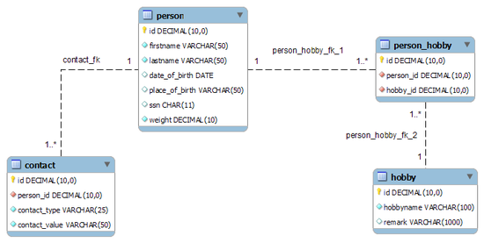
Data organization within TiDB
Dictionary order
TiKV
t1_r1 | {col1, col2, col3 ...}
t1_r2 | {col1, col2, col3 ...}
... | ...
t2_r1 | {col1, col2 ...}
... | ...
tidb-server
Tables (Rows with columns)
Key-value pairs within TiKV
ordered by key

Slide 60
Data organization within TiDB
For a row in a Table, row data is encoded in key-value pairs like this:
t<<tableID>>_r<<rowID>> => [col1, col2, col3, col4]
For unique secondary index:
t<<tableID>>_i<<indexID>>_indexedColumnsValue => rowID
For non-unique secondary index:
t<<tableID>>_i<<indexID>>_indexedColumnsValue_rowID => nil
Notes:
RowID is either generated internally by TiDB or the PK.
If the RowID isn't the primary key: then the primary key is an index pointing to the RowID

Slide 61
Data organization within TiDB
CREATE TABLE user_table (
id INT,
name VARCHAR(64),
email VARCHAR(1024),
PRIMARY KEY(id)
);
user_table
1 | John | john@example.com
2 | Jane | jane@example.com
... | ... | ...
Within TiKV:
t101_r1 => [John,john@example.com]
t101_r2 => [Jane,jane@example.com]
t101_r… => ...

Slide 62
Data organization within TiDB
CREATE TABLE user_table (
id INT,
name VARCHAR(64),
email VARCHAR(1024),
KEY (name),
PRIMARY KEY(id)
);
user_table
1 | John | john@example.com
2 | Jane | jane@example.com
... | ... | ...
Within TiKV:
t101_r1 => [John,john@example.com]
t101_r2 => [Jane,jane@example.com]
t101_r… => ...
...
t101_i1_Jane_2 => nil
t101_i1_John_1 => nil
t101_i1_… => nil

Slide 63
Table Partitioning
Depends on use case, normally TiDB will already improve performance and scalability by distributing the data (can be seen as transparent range sharding/partitioning)
CREATE TABLE t (...) PARTITION BY RANGE (col) (partition p1 values less than (1000000),...)
Good use cases are for fast delete of large amount of data, instead of a big transactional
DELETE FROM t WHERE col < 1000000
do a DDL like
ALTER TABLE t DROP PARTITION p1
which is as fast and efficient as a drop table, but only for a part[ition] to the table.
Another use case is to speed up partial scans in TiFlash, like reports for a single range, then range partitioning makes the scanning to only read matching partitions.

